Slide 1
Data Structures, Algorithms and Design

Slide 2
Module II & III
Linear & Non Linear Data Structure

Slide 3
Plan of Lecture
Linear Data Structure
Stacks
Queues
Non Linear Data Structure
Trees
Heap

Slide 4
Stacks
Stacks

Slide 5
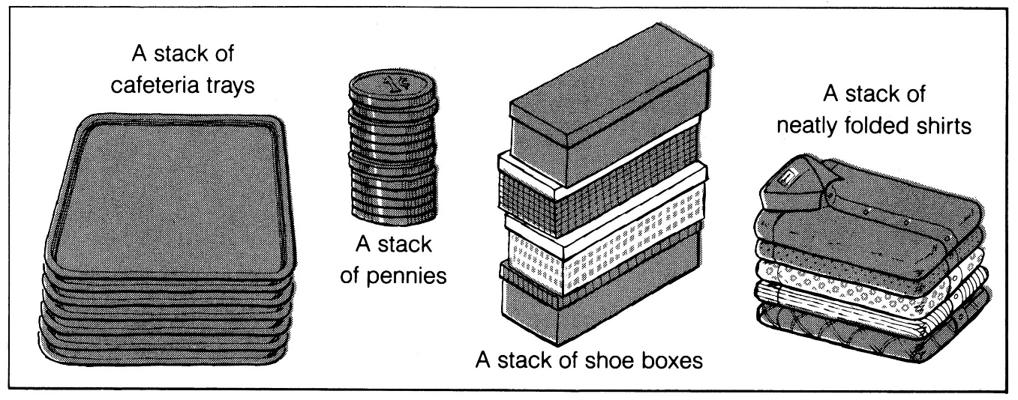
What is a stack?
It is an ordered group of homogeneous items of elements.
Elements are added to and removed from the top of the stack (the most recently added items are at the top of the stack).
The last element to be added is the first to be removed (LIFO: Last In, First Out).

Slide 6
Stack Specification
Definitions: (provided by the user)
MAX_ITEMS: Max number of items that might be on the stack
ItemType: Data type of the items on the stack
Operations
MakeEmpty
Boolean IsEmpty
Boolean IsFull
Push (ItemType newItem)
Pop (ItemType& item)

Slide 7
Operations on stack
Push (ItemType newItem)
Function: Adds newItem to the top of the stack.
Preconditions: Stack has been initialized and is not full.
Postconditions: newItem is at the top of the stack.
Pop (ItemType& item)
Function: Removes topItem from stack and returns it in item.
Preconditions: Stack has been initialized and is not empty.
Postconditions: Top element has been removed from stack and item is a copy of the removed element.

Slide 8
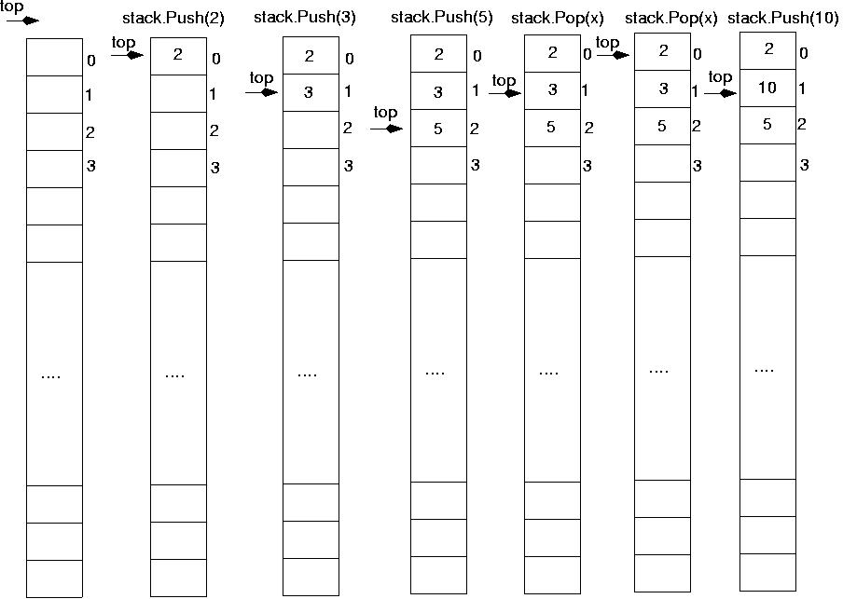
Operations on stack

Slide 9
Stack Implementation
#include "ItemType.h"
// Must be provided by the user of the class
// Contains definitions for MAX_ITEMS and ItemType
class StackType {
public:
StackType();
void MakeEmpty();
bool IsEmpty() const;
bool IsFull() const;
void Push(ItemType);
void Pop(ItemType&);
private:
int top;
ItemType items[MAX_ITEMS];
};

Slide 10
Stack Implementation
StackType::StackType()
{
top = -1;
}
void StackType::MakeEmpty()
{
top = -1;
}
bool StackType::IsEmpty() const
{
return (top == -1);
}

Slide 11
Stack Implementation
bool StackType::IsFull() const
{
return (top == MAX_ITEMS-1);
}
void StackType::Push(ItemType newItem)
{
top++;
items[top] = newItem;
}
void StackType::Pop(ItemType& item)
{
item = items[top];
top--;
}

Slide 12
Exceptions:
Stack overflow
The condition resulting from trying to push an element onto a full stack.
if(!stack.IsFull())
stack.Push(item);
Stack underflow
The condition resulting from trying to pop an empty stack.
if(!stack.IsEmpty())
stack.Pop(item);

Slide 13
Implementation of Stack
Array
Link List

Slide 14
Example: postfix expressions
Postfix notation is another way of writing arithmetic expressions.
In postfix notation, the operator is written after the two operands.
infix: 2+5 postfix: 2 5 +
Expressions are evaluated from left to right.
Precedence rules and parentheses are never needed!!

Slide 15
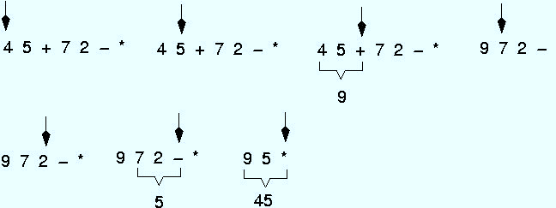
Example: postfix expressions (cont.)

Slide 16
Stack Applications
Stacks are a very common data structure
Compilers
Parsing data between delimiters (brackets)
Operating Systems
Program stack
Virtual Machines
Manipulating numbers
Pop 2 numbers off stack, do work (such as add)
Push result back on stack and repeat
Artificial Intelligence
Finding a path

Slide 17
Finding a Path
Consider the following graph of flights
Z
Key
: city (represented as C)
: flight from city C₁ to city C₂
Y
C₁ C₂
W
S
R
P
T
Example
flight goes from W to S
W
S
X
Q

Slide 18
Finding a Path
If it exists, we can find a path from any city C₁ to another city C₂ using a stack
place the starting city on the bottom of the stack
mark it as visited
pick any arbitrary arrow out of the city
city cannot be marked as visited
place that city on the stack
also mark it as visited
if that’s the destination, we’re done
otherwise, pick an arrow out of the city currently at
next city must not have been visited before
if there are no legitimate arrows out, pop it off the stack and go back to the previous city
repeat this process until the destination is found or all the cities have been visited

Slide 19
Stack is used for:
Page-visited history in a Web browser
Undo sequence in a text editor
Saving local variables when one function calls another, and this one calls another

Slide 20
Stack Summary
Stack Operation Complexity for Different Implementations
Operation | Array Fixed-Size | Array Expandable (doubling strategy) | List Singly-Linked
Pop() | O(1) | O(1) | O(1)
Push(o) | O(1) | O(n) Worst Case O(1) Best Case O(1) Average Case | O(1)
Top() | O(1) | O(1) | O(1)
Size(), isEmpty() | O(1) | O(1) | O(1)

Slide 21
Queues

Slide 22
Queues
A queue is a linear list of elements in which deletion can take place only at one end, called the front, and insertions can take place only at the other end, called the rear.
Queue is also called first-in-first-out (FIFO) lists

Slide 23
Queues
There are main two ways to implement a queue :
Circular queue using array
Linked Structures (Pointers)
Primary queue operations:
Enqueue: insert an element at the rear of the queue
Dequeue: remove an element from the front of the queue

Slide 24
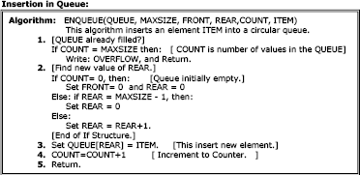
Insertion in Queue (Enqueue)

Slide 25
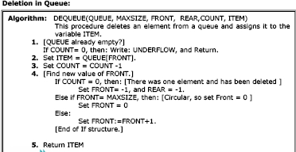
Deletion from Queue (Dequeue)

Slide 26
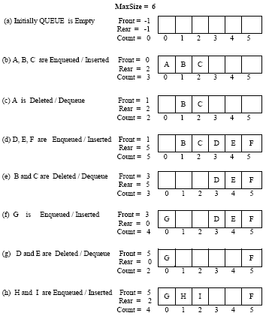

Slide 27
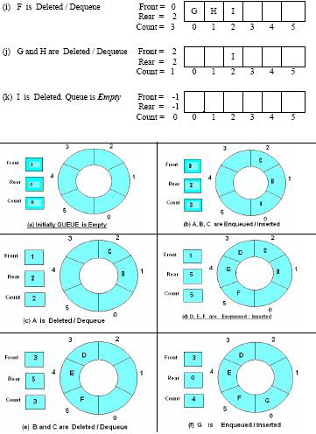

Slide 28
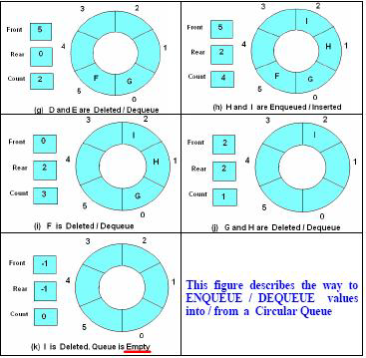

Slide 29
Queue Summary
Queue Operation Complexity for Different Implementations
 | Array Fixed-Size | Array Expandable (doubling strategy) | List Singly-Linked
dequeue() | O(1) | O(1) | O(1)
enqueue(o) | O(1) | O(n) Worst Case O(1) Best Case O(1) Average Case | O(1)
front() | O(1) | O(1) | O(1)
Size(), isEmpty() | O(1) | O(1) | O(1)

Slide 30
Implementing a queue using two stacks (method 1)
Maintain two stacks first and second.
Enqueue operation:
Simply push the elements into the first stack.
Dequeue operation:
Pop from the second stack if the second stack is not empty.
If second stack is empty,
pop from the first stack and push all the elements into second until the first stack becomes empty.
Now pop an element from the second stack and return it.

Slide 31
Implementing a queue using two stacks (method 2)
Maintain two stacks first and second.
Enqueue operation:
While first stack is not empty,
push everything from first stack to second stack.
Push the element to first stack).
Push everything back to first stack.
Dequeue operation:
If first stack is empty then error
Pop an item from first stack and return it
The previous method is better as in this we need to moves all the elements twice in EnQueue operation while we need to moves the elements once and moves elements only if second stack is empty

Slide 32
Implement stack using two queues
Maintain two queues ‘q1′ and ‘q2′ and s is the stack
push(s, x)
Enqueue x to q2
One by one dequeue everything from q1 and enqueue to q2.
Swap the names of q1 and q2 // Swapping of names is done to avoid one more movement of all elements from q2 to q1.
pop(s)
Dequeue an item from q1 and return it.

Slide 33
Implement stack using two queues
Maintain two queues ‘q1′ and ‘q2′ and s is the stack
push(s, x)
Enqueue x to q1.
pop(s)
One by one dequeue everything except the last element from q1 and enqueue to q2.
Dequeue the last item of q1, the dequeued item is result, store it.
Swap the names of q1 and q2
Return the item stored in step 2. // Swapping of names is done to avoid one more movement of all elements from q2 to q1.

Slide 34
Binary Trees

Slide 35
Definition
A tree t is a finite nonempty set of elements.
One of these elements is called the root.
The remaining elements, if any, are partitioned into trees, which are called the subtrees of t.

Slide 36
Tree
Joe
Ann
Mary
John
Mark
Sue
Chris

Slide 37
Levels of a Tree
Joe
Level0
Ann
Mary
John
Level1
Mark
Sue
Chris
Level2

Slide 38
Node Degree = Number Of Children
Joe
3
Ann
Mary
John
2
0
1
Mark
Sue
Chris
0
0
0

Slide 39
Tree Degree = Max Node Degree
Degree of tree = 3.
Joe
3
Ann
Mary
John
2
0
1
Mark
Sue
Chris
0
0
0

Slide 40
Binary Tree
Finite (possibly empty) collection of elements.
A nonempty binary tree has a root element.
The remaining elements (if any) are partitioned into two binary trees.
These are called the left and right subtrees of the binary tree.

Slide 41
Differences Between A Tree & A Binary Tree
No node in a binary tree may have a degree more than 2,
whereas there is no limit on the degree of a node in a tree.
A binary tree may be empty; a tree cannot be empty.

Slide 42
Differences Between A Tree & A Binary Tree
The subtrees of a binary tree are ordered; those of a tree are not ordered.
Are different when viewed as binary trees.
Are the same when viewed as trees.
a
a
b
b

Slide 43
Binary Tree Form
(a + b) * (c – d) / (e + f)
/
/
*
+
e
f
+
-
a
b
c
d

Slide 44
Binary Tree Properties & Representation

Slide 45
Minimum Number Of Nodes
Minimum number of nodes in a binary tree whose height is h.
At least one node at each of first h levels.
minimum number of nodes is h

Slide 46
Maximum Number Of Nodes
All possible nodes at first h levels are present.
Maximum number of nodes
= 1 + 2 + 4 + 8 + … + 2^{h-1}
= 2^{h} - 1

Slide 47
Number Of Nodes & Height
Let n be the number of nodes in a binary tree whose height is h.
h <= n <= 2^{h} – 1
log₂(n+1) <= h <= n

Slide 48
Full Binary Tree
A full binary tree of a given height h has 2^{h} – 1 nodes.
Height 4 full binary tree.

Slide 49
Numbering Nodes In A Full Binary Tree
Number the nodes 1 through 2^{h} – 1.
Number by levels from top to bottom.
Within a level number from left to right.
1
2
3
4
5
6
7
8
9
10
11
12
13
14
15

Slide 50
Node Number Properties
Parent of node i is node i/2, unless i = 1.
Node 1 is the root and has no parent.
1
2
3
4
5
6
7
8
9
10
11
12
13
14
15

Slide 51
Node Number Properties
Left child of node i is node 2i, unless 2i > n, where n is the number of nodes.
If 2i > n, node i has no left child.
1
2
3
4
5
6
7
8
9
10
11
12
13
14
15

Slide 52
Node Number Properties
Right child of node i is node 2i+1, unless 2i+1 > n, where n is the number of nodes.
If 2i+1 > n, node i has no right child.
1
2
3
4
5
6
7
8
9
10
11
12
13
14
15

Slide 53
Complete Binary Tree With n Nodes
Start with a full binary tree that has at least n nodes.
Number the nodes as described earlier.
The binary tree defined by the nodes numbered 1 through n is the unique n node complete binary tree.

Slide 54
Example
Complete binary tree with 10 nodes.
1
2
3
4
5
6
7
8
9
10
11
12
13
14
15

Slide 55
Some Binary Tree Operations
Determine the height.
Determine the number of nodes.
Make a clone.
Determine if two binary trees are clones.
Display the binary tree.
Evaluate the arithmetic expression represented by a binary tree.
Obtain the infix form of an expression.
Obtain the prefix form of an expression.
Obtain the postfix form of an expression.

Slide 56
Binary Tree Traversal
Many binary tree operations are done by performing a traversal of the binary tree.
In a traversal, each element of the binary tree is visited exactly once.
During the visit of an element, all action (make a clone, display, evaluate the operator, etc.) with respect to this element is taken.

Slide 57
Binary Tree Traversal Methods
Preorder
Inorder
Postorder

Slide 58
Preorder Traversal
void preOrder(BinaryTreeNode t)
{
if (t != null)
{
visit(t);
preOrder(t.leftChild);
preOrder(t.rightChild);
}
}
Notes:
t is the root of the subtree being traversed.

Slide 59
Preorder Example (visit = print)
a
b
c
a
b
c

Slide 60
Preorder Example (visit = print)
a
b
c
f
d
e
g
j
h
i
a
b
d
g
h
e
i
c
f
j
Notes:
During the traversal, t starts at the root, moves to the left child b of the root, then to the left child d of b. When the traversal of the left subtree of b is complete, t, once again, points to the node b. The t moves into the right subtree of b. When the traversal of this right subtree is complete, t again points to b. Following this, t points to a. We see that t points to every node in the binary tree three times – once when you get to the node from its parent (or in the case of the root, t is initially at the root), once when you return from the left subtree of the node, and once when you return from the node’s right subtree. Of these three times that t points to a node, the node is visited the first time.

Slide 61
Preorder Of Expression Tree
/
*
+
e
f
+
-
a
b
c
d
/
*
+
a
b
-
c
d
+
e
f
Gives prefix form of expression!

Slide 62
Inorder Traversal
void inOrder(BinaryTreeNode t)
{
if (t != null)
{
inOrder(t.leftChild);
visit(t);
inOrder(t.rightChild);
}
}

Slide 63
Inorder Example (visit = print)
a
b
c
b
a
c

Slide 64
Inorder Example (visit = print)
a
b
c
f
d
e
g
j
h
i
g
d
h
b
e
i
a
f
j
c

Slide 65
Inorder Of Expression Tree
/
*
+
e
f
+
-
a
b
c
d
Gives infix form of expression
a
+
b
*
c
-
d
/
e
+
f

Slide 66
Postorder Traversal
void postOrder(BinaryTreeNode t)
{
if (t != null)
{
postOrder(t.leftChild);
postOrder(t.rightChild);
visit(t);
}
}

Slide 67
Postorder Example (visit = print)
a
b
c
b
c
a

Slide 68
Postorder Example (visit = print)
a
b
c
f
d
e
g
j
h
i
g
h
d
i
e
b
j
f
c
a

Slide 69
Postorder Of Expression Tree
/
*
+
e
f
+
-
a
b
c
d
a
b
+
c
d
-
*
e
f
+
/
Gives postfix form of expression!

Slide 70
Binary tree traversal
Traversing a tree = visiting its nodes
There are three ways to traverse a binary tree
preorder : visit root,
visit left subtree,
visit right subtree
inorder : visit left subtree,
visit root,
visit right subtree
postorder : visit left subtree,
visit right subtree,
visit root

Slide 71
Binary Tree Construction
Can you construct the binary tree, given two traversal sequences?
Depends on which two sequences are given

Slide 72
Inorder And Preorder
a
inorder = g d h b e i a f j c
preorder = a b d g h e i c f j
Scan the preorder left to right using the inorder to separate left and right subtrees
a is the root of the tree; gdhbei are in the left subtree; fjc are in the right subtree
b is the next root; gdh are in the left subtree; ei are in the right subtree
d is the next root; g is in the left subtree; h is in the right subtree
gdhbei
fjc
a
b
fjc
gdh
ei
a
b
fjc
d
ei
g
h

Slide 73
Inorder And Postorder
Scan postorder from right to left using inorder to separate left and right subtrees
inorder = g d h b e i a f j c
postorder = g h d i e b j f c a
Tree root is a; gdhbei are in left subtree; fjc are in right subtree

Slide 74
Preorder And Postorder
a
a
preorder = ab
postorder = ba
b
b
Preorder and postorder do not uniquely define a binary tree.
Nor do preorder and level order (same example)
Nor do postorder and level order (same example)

Slide 75
Homework
Give an O(n)-time algorithm for computing the depths of all the nodes of a tree T, where n is the number of nodes of T.

Slide 76
depths of all the nodes of a tree
Algorithm computingDepths(v, d)
{
v.depth=d;
if ( v has no child )
return;
else
for each child v′ do
computingDepths(v′, d+1));
return;
}
To compute the depth of each node, simply call computeDepth(root, 0). This algorithm visits each node only once and each visit takes constant time. Therefore, it’s running time is O(n).

Slide 77
Heaps

Slide 78
Heap
Representations

Slide 79
Heap
Insertion and deletion of elements

Slide 80
Heap
Heap implementation of priority queue

Slide 81
Heap
Heap sort

Slide 82
Thank You

